Slide 1
The Team
Name: EduExo
Members | Roles
Adebola Tunmife | Team Leader/Project Manager
Adesipe Emmanuel | Frontend Developer
Adebola Simeon | Backend Developer
Samuel Ladipo | Backend Developer
Obi-Anuonye Ugochukwu | Frontend Developer.
Project Challenge: Chronicles of Exoplanet Exploration

Slide 2
Purpose
Welcome to ExoExplorer: Exploring the Universe Beyond
Project Purpose The ultimate goal of ExoExplorer is to raise awareness and spark public interest in exoplanetary science and space exploration. We aim to make exoplanet data more approachable for a wide audience, including students, educators, space enthusiasts, and most importantly: underserved communities who have little to no access to learning materials for exoplanets. By delivering engaging content and interactive features, we hope to inspire a new generation of space explorers and scientists.

Slide 3
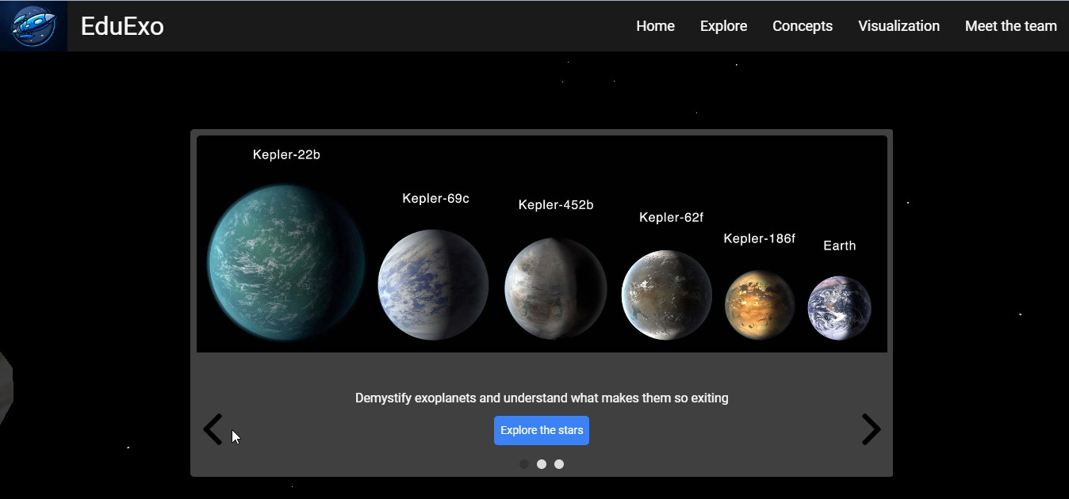
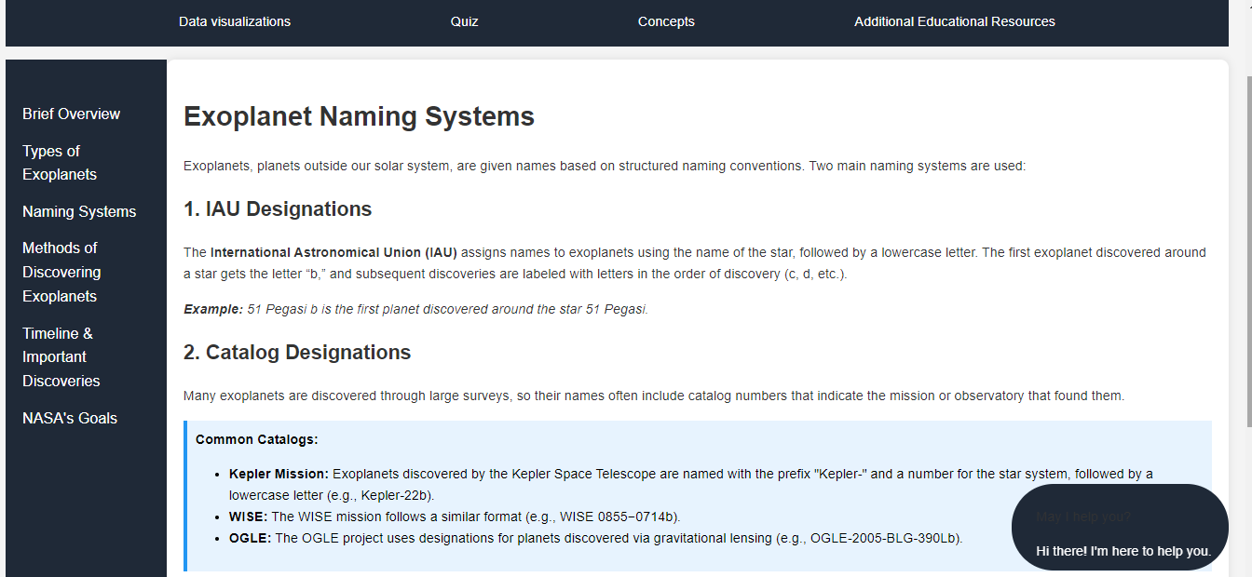
Features
Interactive Educational UI ExoExplorer’s Interactive UI is designed to immerse users in a fun and engaging educational experience from the moment they start. The platform combines easy navigation with dynamic elements like hover effects, clickable charts, and tooltips, ensuring that users of all ages and knowledge levels can explore exoplanets with ease.
4o
Educational Concepts At its core, ExoExplorer prioritizes educational content for students and learners. Each exoplanet entry is accompanied by detailed explanations of its characteristics, how it was discovered, and why it’s significant to the study of space. Educational modules introduce fundamental astronomy concepts, like the transit method, radial velocity, and the criteria for a planet to be considered habitable. These sections are tailored for easy understanding, providing accessible knowledge to both novice learners and aspiring space enthusiasts.
Page on Naming Systems for Exoplanets

Slide 4
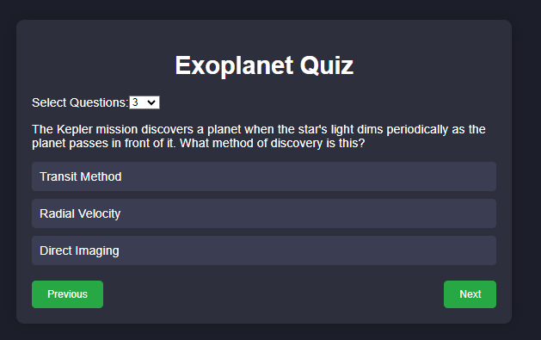
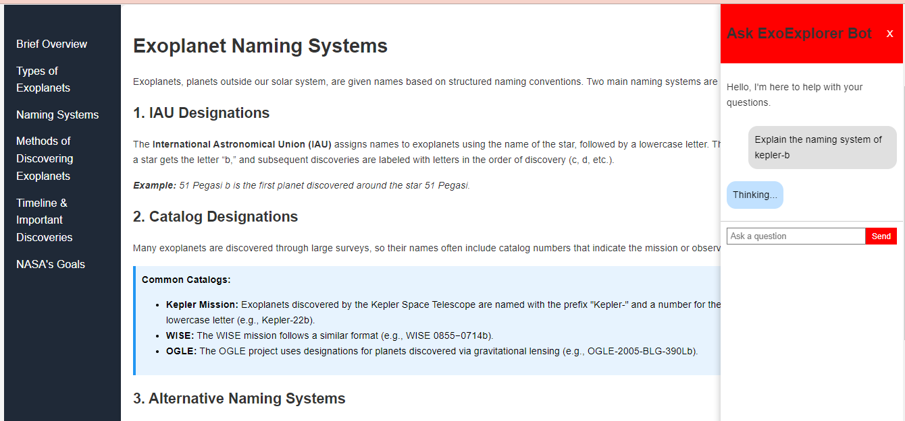
Features Contd.
Interactive Quizzes Our Interactive Quizzes feature utilizes generative AI to dynamically create quizzes tailored to the learner's current knowledge level. These quizzes help students test their understanding of exoplanets, offering instant feedback. The AI-generated questions are diverse, ranging from multiple-choice to true/false, with explanations for each answer, making it an interactive and valuable tool for students who want to solidify their grasp of space science concepts.
Quiz On Methods of discovering Exoplanets
Interactive Chatbot Teacher The Interactive Chatbot Teacher is a 24/7 virtual assistant, powered by AI, designed to answer questions about exoplanets and the broader universe. Users can engage in real-time conversations to gain explanations about various exoplanetary phenomena, ranging from simple queries like "What is an exoplanet?" to more complex topics like "How do scientists detect planets orbiting distant stars?" This chatbot makes learning feel more personalized and accessible, ensuring users have a knowledgeable companion throughout their exploration.
Chatbot answering questions about the Naming System of an exoplanet

Slide 5
Data Sources and Accuracy
We endeavoured to make our work as reliable as possible which is why we made sure to get the necessary information and data needed for the project from the right sources. This Include:
Nasa Exoplanet Page(https://science.nasa.gov/exoplanets/):
This resource provided us with the proper foundational concepts about exoplanets and allowed us(the team) to gain the proper knowledge base we would need to work on our project.
Nasa Exoplanet Archive(https://exoplanetarchive.ipac.caltech.edu/):
Provided us with readily available data on exoplanet features for us to integrate into our project.

Slide 6
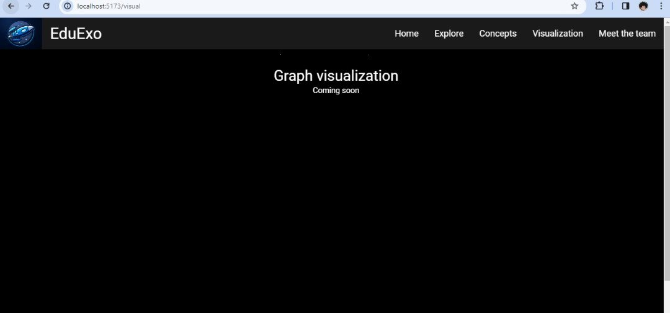
Additional Features and Upgrades
Data Visualizations (Additional Feature)
Using data from NASA’s Exoplanet Archive, ExoExplorer creates interactive visualizations that allow users to explore exoplanetary features like detection methods, distance from Earth, and planetary types. These visualizations include bar charts, scatter plots, and histograms that are dynamically generated to help users visually compare and analyze exoplanet data.
Coming soon

